Slide 1

An ecological process-based model of wild boar
Mossa M. Reimert, Matt Denwood, Anette Boklund,
Department of Veterinary and Animal Sciences @ University of Copenhagen, Denmark
Notes:
An ecological process-based model of wild boar
Objectives: Models of disease spread in livestock must take into account the influence of wildlife in order to provide a realistic estimate of the expected size of an epidemic. Existing models of ASF are predominantly outcome focused, meaning that model parameters are calibrated to match population-wide statistics estimated from field studies. However, this approach may not fully capture the necessary features of the underlying system. Materials and Methods: We use an entity-component system in the low-level programming language Rust to implement a process-oriented ecological model of wild boar breeding, mortality and dispersal. We include both seasonality and effects of density in order to more closely follow the biological drivers of the underlying ecological processes. We consider the impact of this alternative configuration on the spread of a simplified ASF-like disease. Danish land cover data is used to generate indicators of habitable regions and their corresponding carrying capacity for wild boar, and the spatial structure is represented by dividing the landscape into 3.5 km2 hexagons with an associated network structure representing adjacency. Results: The duration of the epidemic and the extent of the potentially affected region are strongly influenced by the modelled ecological processes. The relative contribution of each aspect of the ecological process is quantified using sensitivity analysis. Discussion: Differing approaches to modelling wild boar breeding and dispersal can have a large effect on the estimated spread of disease over a geographical area. Careful consideration of the underlying biology of these processes is therefore needed in order to ensure that the inference in terms of risk of transmission to domestic pigs is reasonable. The use of entity-component systems to model these processes provides substantial benefits in terms of computational burden and adaptability of the overall model.
Reimert M ¹ , Boklund A , Denwood M¹ University Of Copenhagen, Frederiksberg Sjælland, Denmark

Slide 2
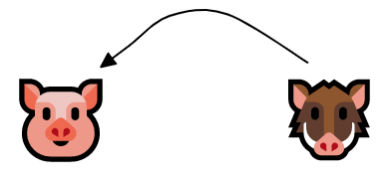
Overall objective
Explore the interplay between wildlife and domestic pig productions under an outbreak of African Swine Fever (ASF).
In case of wild boars in Denmark and ASF in Germany, how likely are spill-overs from wildlife to domestic pig productions?
How are these spill-overs affected by wild boar ecology assumptions?
Specific for this talk
Notes:
Assuming that wildlife is reservoir for disease.
We will look at the spill-over events of disease from
Wildlife.
ASF could potentially be introduced to Denmark by way of
Germany;
Everything centers around these spill-over events.
We are not actually counting spill-over events, but the 3rd degree spatial infection pressure on pig farms; This is basis for a further analysis, but the properties of the spread vector should be part of the analysis.
Mechanical vector maybe?

Slide 3
Ecological processes & data

Slide 4
Data availability
 | 🐗 | 🐷
Locations / Habitat suitability | Corine Land usage | The Central Husbandry Register (CHR)
Movements | Published data on migration distances | Movement data
Breeding / Death | Published data on litter size, survival, and breeding rates | Assume constant population size
Wild boar = Challenging Pigs = Easy
Notes:
We don’t currently have wild boar in Denmark.
Wild boar and ASF will be introduced from border of Germany (as one plausible incursion route)
Therefore we lack information about how a wild boar population would look like in Denmark.
While domestic pigs, we (almost) have full information.
Domestic pig is a well understand population.
We know where they are, and herd sizes, also animal movements is fully known.
That’s not the case with wild boar;
They are not present in Denmark officially;
Thus we have to simulate the population from the ground up.
Habitat quality is not known for Denmark either; Usually hunting bags are used for this; But those are especially unreliable for Denmark.
We thus use the Corine Land usage data to estimate habitat suitability.

Slide 5
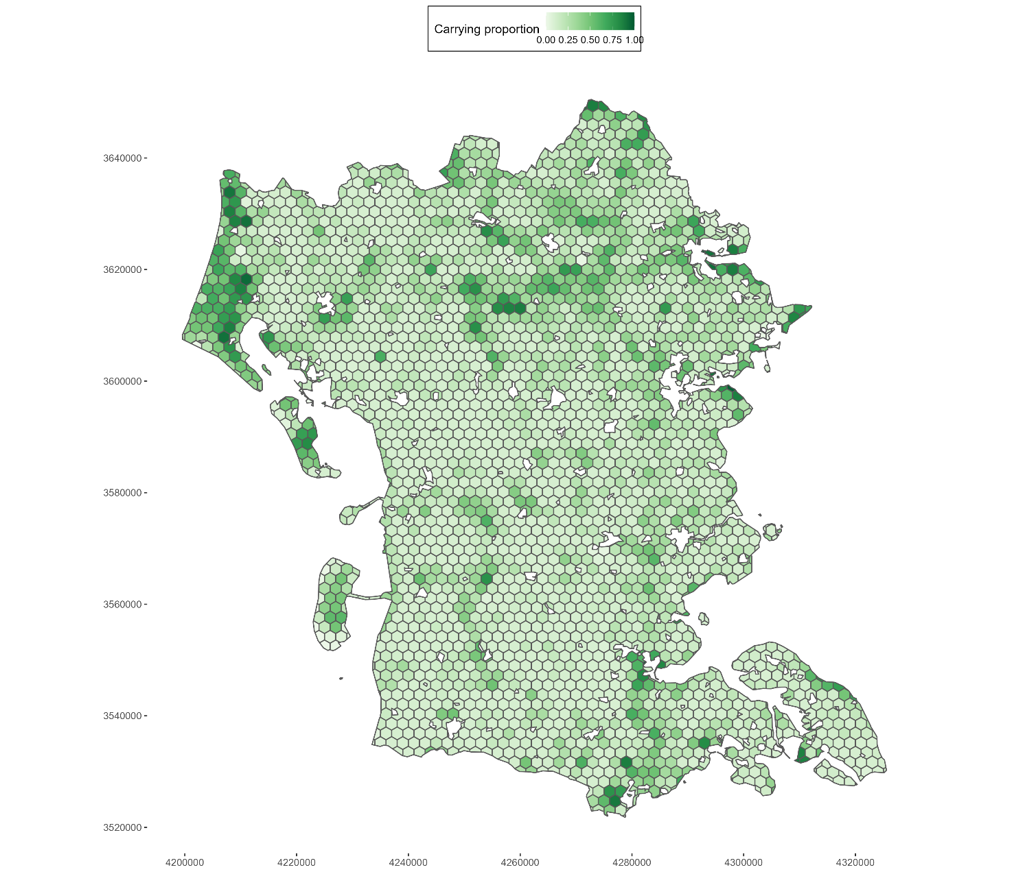
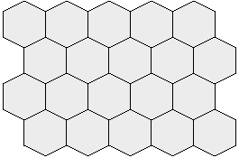
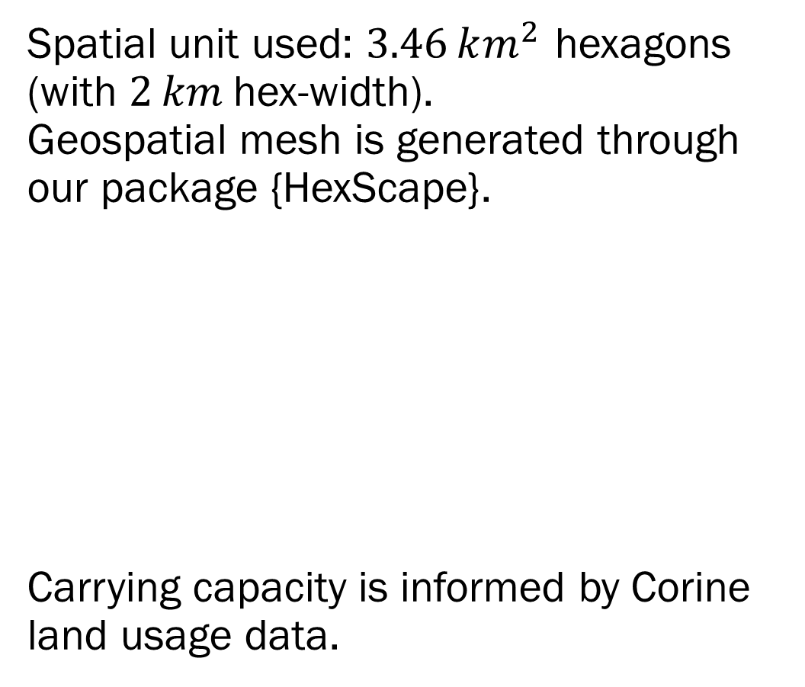
Spatial clustering of wild boar habitat
Spatial unit used: $3.46 km^{2}$ hexagons (with $2 km$hex-width). Geospatial mesh is generated through our package {HexScape}.
Carrying capacity is informed by Corine land usage data.
Notes:
Spatial setting is patch-based. Each of our patch is a potential / candidate home-range. We use hexagons to tessellate the landscape;
This is then overlayed with an estimated carrying capacity, which is total number of mature animals that a patch my sustain at any given time.
Max carrying capacity is 25 animals, and breeding capacity is CC / 3.

Slide 6
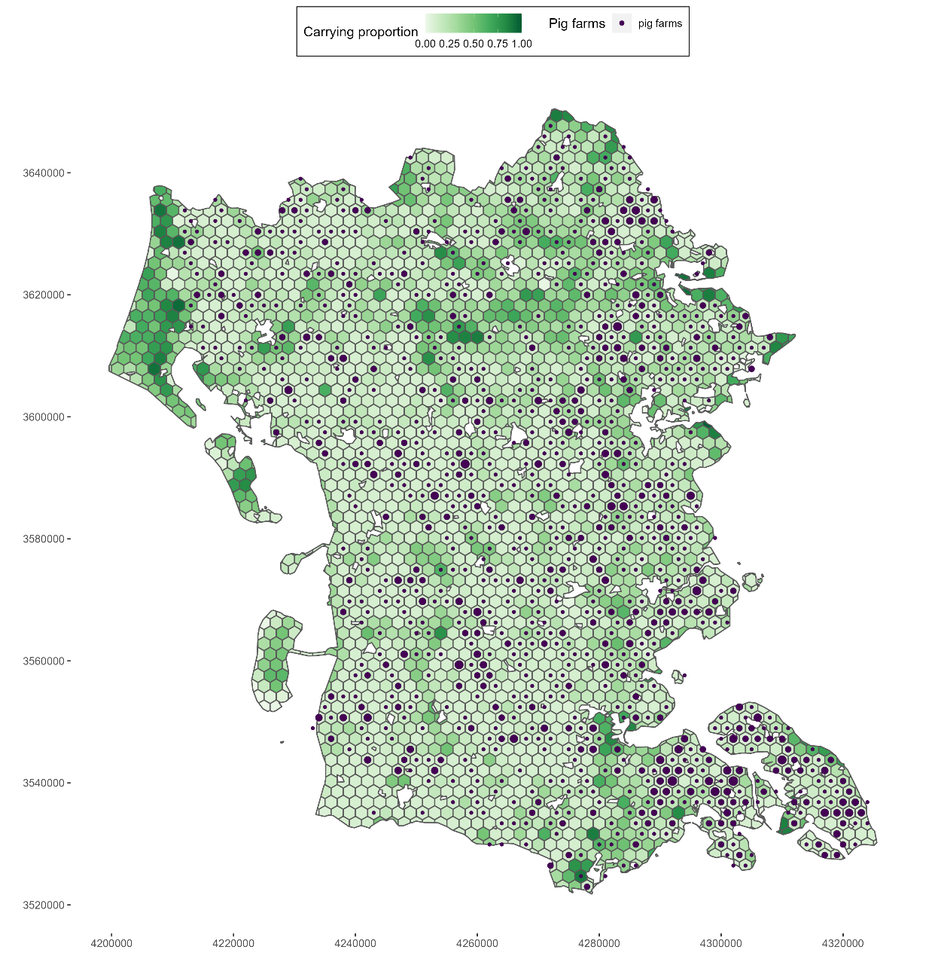

Spatial locations of pig farms
GIS coordinates of pig farms are mapped to these hexagons
Notes:
We overlayed the actual pig farms locations to
Home-ranges are typically denoted by non-farmland, arable land;
Thus where pigs are most likely to reside is not within patches where wild boars are typically located.
We have the German border to the South here.
But they are within close proximity!

Slide 7
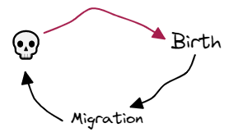
Wild boar ecology: Birth, death and migration assumptions
⇒ Birth constrained by habitat density informed by land usage data.
⇒ Death is constant for all.
⇒ Migration is caused by over-population.
Notes:
For now, we will omit the emergent population.
As before, we cannot settle for a static (in time) population model for wild boar. The emergent population and how it will behave under an outbreak is also of interest.
Wild boar ecology is straight forward: We have birth, death and migration.
Birth is constrained by the breeding capacity for each patch. Death is constant for all pigs (except for piglets)
Migration is caused by overpopulation.
These processes affect each other in various ways, that we should keep note of.
Of course these processes influence each other in sometimes surprising ways; Bear that in mind please

Slide 8
Models

Slide 9
Modelling setup
Domestic pigs are the target spill-over population
Transmission of ASF occurs between wild boar and domestic pigs within their home-range
Transmission of ASF within a hexagon is frequency dependent
Transmission of ASF between hexagons is density-dependent over the spatial landscape
100% mortality of ASF in wild boar.
Carcasses may transmit ASF back to living animals
The ASF transmission part of the model is implemented at UCPH within
the BLOFELD Modelling Framework
Notes:
Frequency is where you divide by 1/N.

Slide 10
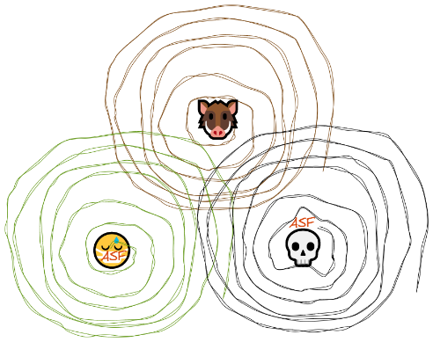
Modelling scenarios
Three different variants of wild boar ecology:
A. Uniform replacement of wild boar
B. Diffusion based replacement of wild boar
C. Agent-based Model for wild boar based on ECS
All with:
Stable wild boar population in the southeast of Jutland
ASF seeded into the same border patch every year
Simulation run for 10 years
Recording of number of spill-overs into domestic pig farms under (A), (B), and (C)
Notes:
For now, we will omit the emergent population.
Important: we continue seeding ASF in the scenario via a bordering patch to Germany at the beginning of every year.
Spill-over is 3 degrees spatially sensitive
Migration is 10 degrees spatially sensitive
ASF is 5 degrees spatially sensitive.
Carcasses is 1 degrees sensitivity (within patch, and neighbouring)
Migration trajectories are null in (A) and (B), and is only possible to explore in (C).
While model (B) is very composable, computationally tractable, it may not capture non-linearities that the ABM will be able to capture.
Only slightly misleading picture, that death is not distance

Slide 11
Results

Slide 12
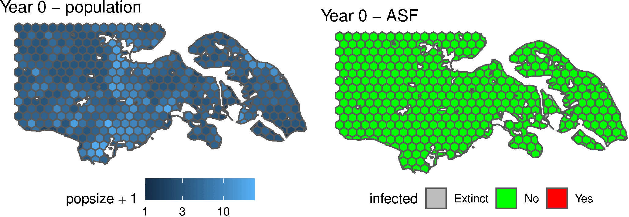
Model (A): Uniform replacement of wild boar
Model (B): Diffusion based replacement of wild boar
:
Notes:
Results: single iteration
Breed @ 30 day (in the year)
Migration @ 50 day (in the year)
(ASF) incursion @ 60 day (in the year)
Constant / uniform migration

Slide 13
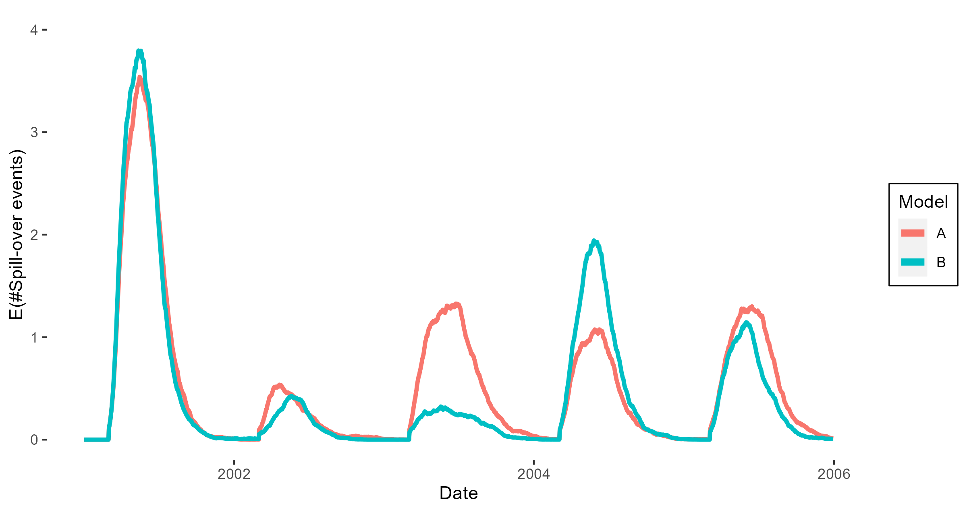
Results: expected number of spill-over events
Notes:
As for the spill-over events (mean of) the reincursion the disease tells us how it will behave over different state of the population.
In model A, where we are quickly to repopulate the landscape, ASF takes hold and reaches the pig farms again, while in the more diffused migration, ASF tends to decimate the population as the population is down again.
(this is done across many iterations also)
E(compartments)
E(spill over events)

Slide 14
Ongoing development of ECS
Model (C): Entity Component System architecture Agent-based Models
Notes:
This brings us to why model (C) could be useful and what we would actually like to see from it.

Slide 15
Wild boar dispersal patterns are vital
Model (C) should present migration patterns that are different to (A) and (B); Otherwise use (A) and (B) as they are simpler
Model (C) has to deal with interactions that are not present in model (A) and (B), e.g.:
Overpopulation; Density dependent piglet mortality when the carrying capacity of the patch is exceeded by number of mature animals within the patch.
Other examples: Next slide!
Notes:
Migration patterns are important.
Quite frankly if your ABM model can be approximated completely by a compartmental model, you should reconsider the validity of your ABM.
Here we clearly would like to memic natural migration, but if the resulting pattern resembles either model (A) or (B) then it was all for naught. And there is more insight there then a moderately complex, and very detailed ABM.
Model (A) and Model (B) shows the importance of this on the distribution of spill-over events (into pig farms).
Thus, we wish for an ABM that accurately reflect how the emergent
Migration patterns would look like in case of an ASF outbreak.
Model (C) should be robust to rapid changes in the wild boar population.
We cannot just rely on a model that is able to maintain steady-state.
It should also reach steady-state even if too many animals suddenly reside in one patch, or if the population is near extinction.

Slide 16
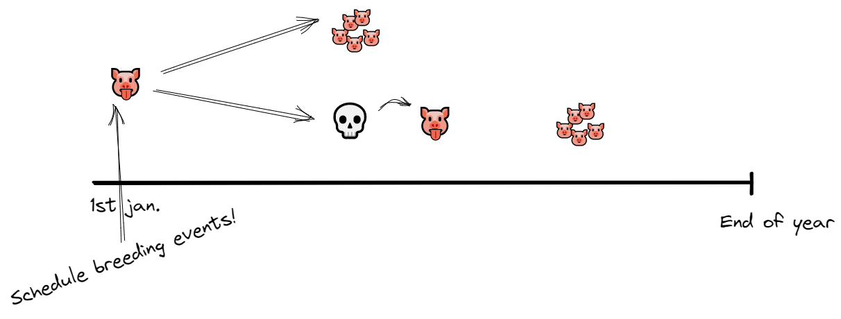
Reschedule breeding events
Replace breeding events caused by death of a sow before the breeding date
Notes:
When death affects breeding, we would like for it to

Slide 17
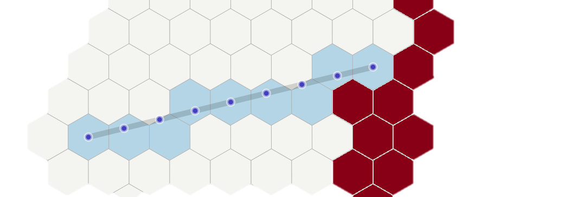
Migration
Dispersal follows a semi-random walk in the landscape. Not enough unfortunately!
⇒ Aimless moving groups when faced with blocked terrain
Solution:
Live heading estimation
Density-dependent settling probabilities

Slide 18
ECS architecture for Agent-based Models
ECS allows to organise code that deals with these interactions in a modular way.
A graph facilitates relations between (static) data
An ECS facilitates relations between processes
ABM has synchronous and asynchronous parts which can be organised by an ECS, e.g.:
Evolve state (synchronous) ↦
Observe / Aggregate (asynchronous) ↦
Trace (micro / macro) (asynchronous / IO)

Slide 19
Conclusions

Slide 20
Conclusions
Ecological processes can have a dominant effect on the overall spread of disease from wildlife reservoirs into domestic animals.
Data on wildlife is scarce; But the processes themselves should not be omitted.
ECS architecture may help deal with growing complexity of wildlife models

Slide 21
Thanks for your attention; More to come, bye for now
If you have any questions or an interest within this area, then please feel free to reach out. mossa@sund.ku.dk {HexScape}: https://github.com/ku-awdc/hexscape

